Slide 1

School Buddy Performance Analysis(2019-2021)
An Analytical Report for School Buddy Powered By
Shubham
Feb 5, 2025

Slide 2
Understanding the Problem
School Buddy helps students find the best schools based on their preferred streams.
The dataset includes marks from 2019-2021 for five schools in Bangalore.
Our goal is to analyze student performance and derive key insights.
School Buddy has collected marks scored by the same students for all the subjects for 3 consecutive years.
Subjects for each of these streams are as follows:
Arts - Hindi, English, History, Geography and Civics
Science - Mathematics, Physics, Chemistry, Biology and Computer Science
Commerce - Hindi, English, Mathematics, Computer Science and Physical Education

Slide 3
Data and Approach
Dataset:
Source: School Buddy’s collected student marks (2019-2021)
Structure: Marks across subjects for five schools
Methodology:
Data Cleaning & Transformation
SQL-based Queries in SQLite
Python-based Visualization using Matplotlib & Seaborn
Google Slides for Charts & Presentation

Slide 4
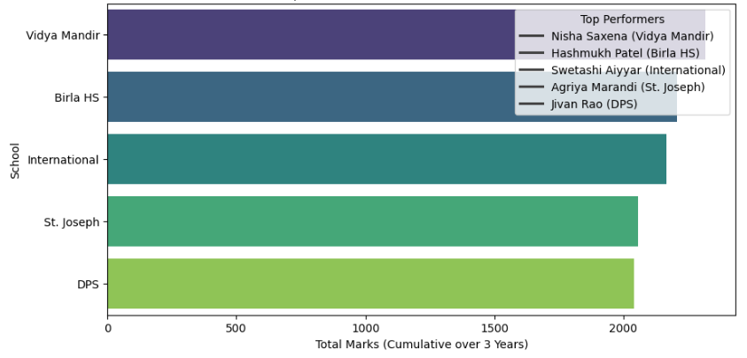
Top Performers of Each School

Slide 5
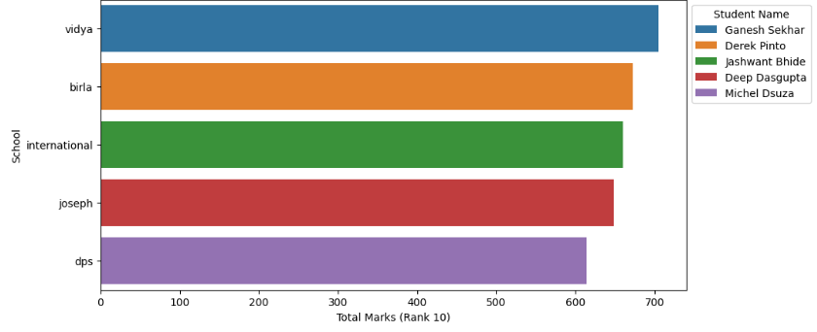
Rank Comparison - 2020

Slide 6
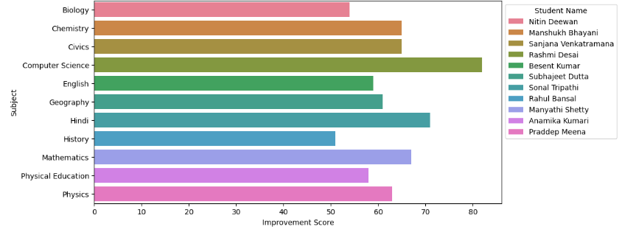
Students with Highest Improvement (2019-2021)

Slide 7
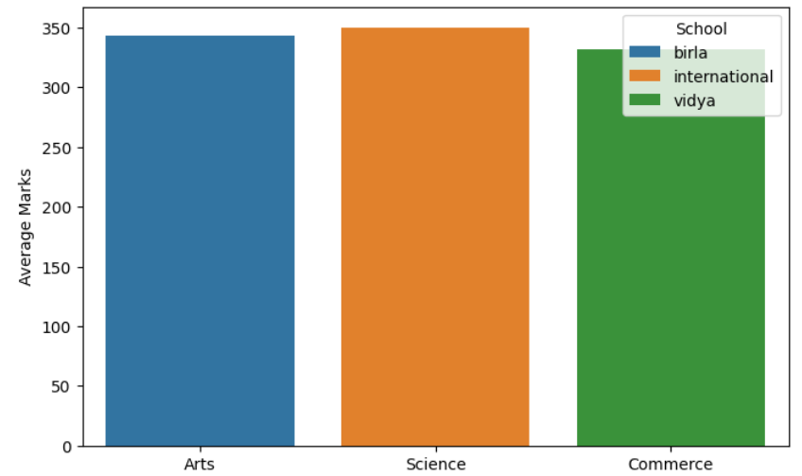
Best Schools for Arts, Science & Commerce

Slide 8
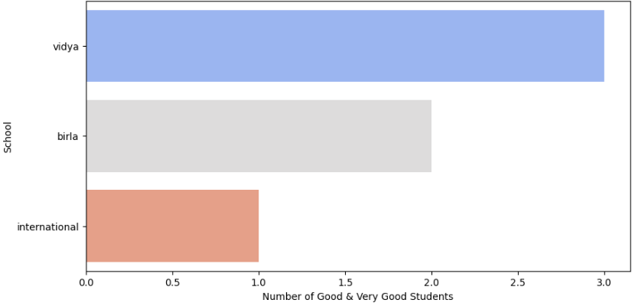
Student Performance

Slide 9
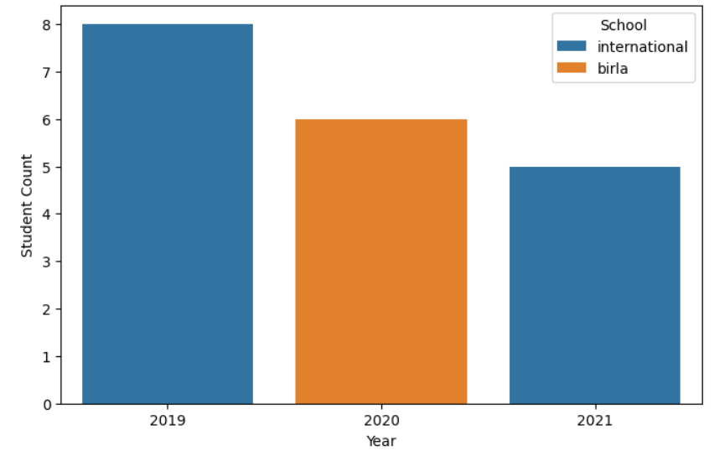
Best School Per Year (2019, 2020, 2021)

Slide 10
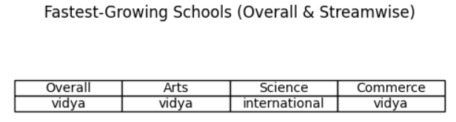
Fastest-Growing School in Bangalore

Slide 11
Final Insights
Summary of Findings:
Top Schools Per Year:
2019: International
2020: Birla
2021: International
Best Schools Per Stream:
Arts: Birla
Science: International
Commerce: Vidya Mandir
Fastest-Growing Schools:
Overall: Vidya Mandir
Arts: Vidya Mandir
Science: International
Commerce: Vidya Mandir

